Slide 1
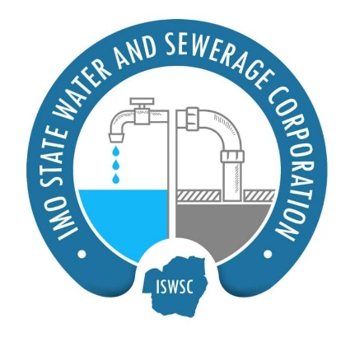

UNDERSTANDING NON REVENUE WATER
IMO STATE WATER AND SEWERAGE CORPORATION, NIGERIA
Presented By
Engr. Henry Oluchukwu Adiruo_{MNSE,MNAHS}
Head, Water Services Department

Slide 2
INTRODUCTION OF IMO STATE WATER AND SEWERAGE CORPORATION
The Imo State Water Corporation was established in 1976
It is the agency charged with the establishment and control of all water works in urban areas. It is mandated to sell water, charge and collect water bills at a rate fixed by the Government.
MISSION: Provision of sustainable safely managed water and sewerage services to residents of Imo and its environs through the use of available environmental friendly technology.
VISION: To be the most innovative water and sewerage utility in Africa
CORE VALUE: customer satisfaction, collaboration, professionalism, integrity, teamwork and transparency

Slide 3
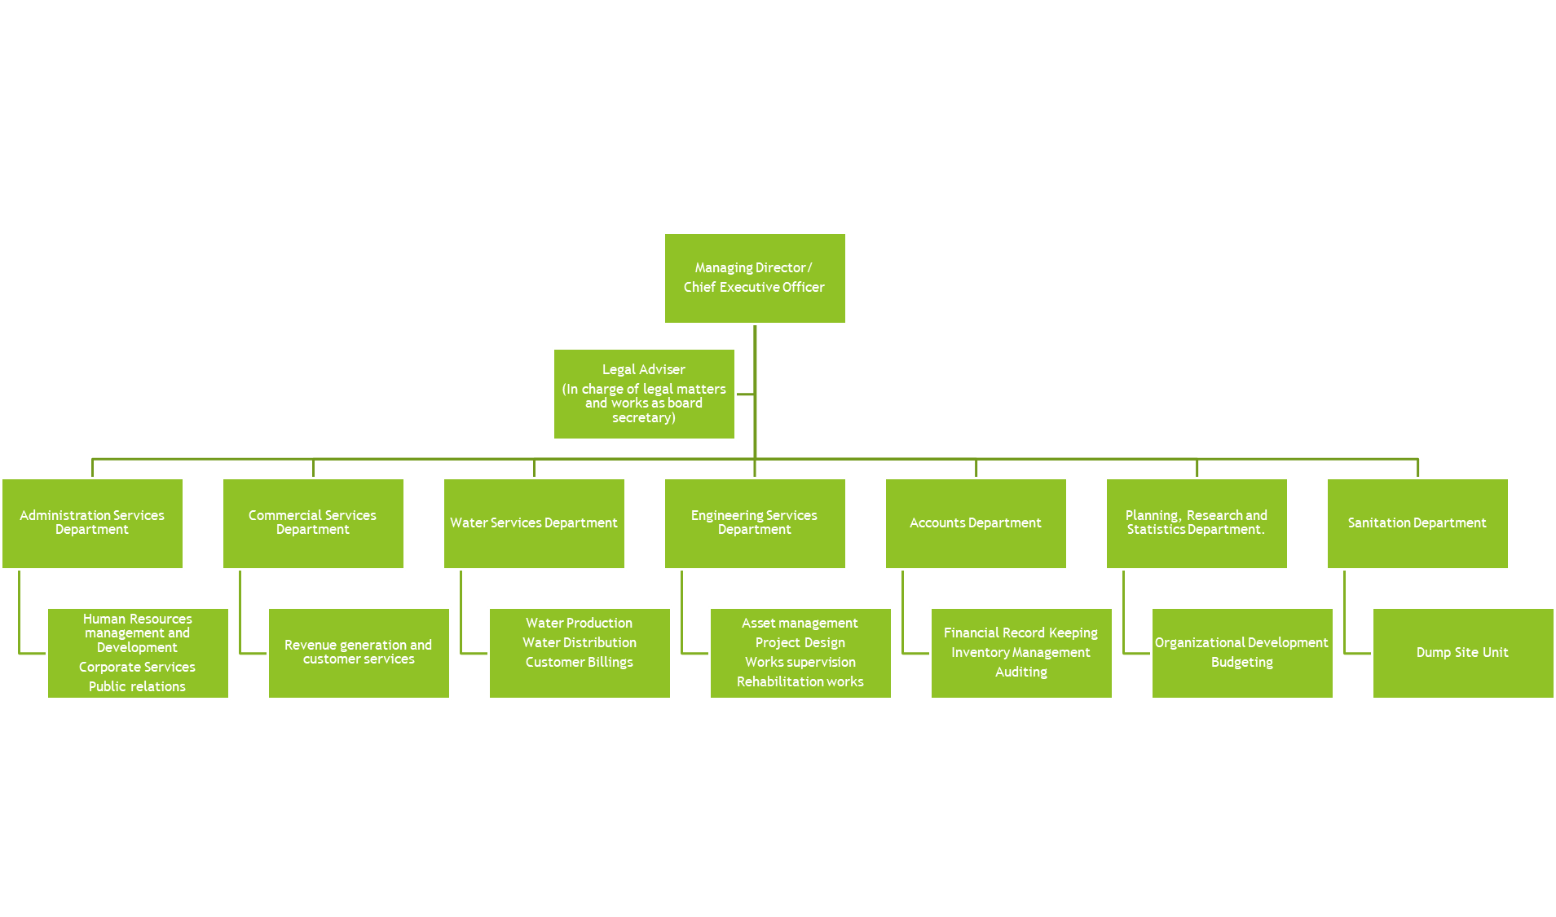
ORGANISATIONAL STRUCTURE OF IMO STATE WATER AND SEWERAGE CORPORATION

Slide 4


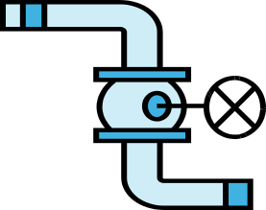

Water Supply Process
River “source”
Add chemicals
Stir
Settle
Filter
Distribute
Store
Disinfect

Slide 5
CHALLENGES OF ISWSC IMPACTING NRW
NRW is simply water that was produced but did not contribute to the revenue base of the organization.
NRW can occur through physical losses in the operation of the system and through commercial losses
ISWSC is struggling with high NRW through both physical and commercial losses
Prominent features of the water corporation include
  Dilapidated water supply systems that are suspectible to failure at critical moments
  Old pumps and fittings leak water during operation
  Poor maintenance culture leaves operational components in poor condition
  Construction works for developmental projects keeps damaging water pipelines
  Burreaucratic bottlenecks affects response to detected leaks
  Leak detection and repair teams are poorly equipped for their job
  Clogged filter beds cause a lot of water overflow and require frequent back washings
  Faulty backwash system

Slide 6
THE PROBLEM OF NRW IN THE STATE
Poor revenue base hampers necessary investment to keep the system stable
Porous revenue collection system
Other factors aiding non revenue water from commercial view point
  Inadequate data on customer base
  Manual billing method
  Poor logistics in bill distribution
  Poor logistics in revenue collection
  Manual accounting method
  Sharp practices

Slide 7
STRATEGY FOR REDUCING PHYSICAL LOSSES
Set up NRW reduction team
Ensure quick response to fix detected leaks
Introducing active leakage control to detect further leaks
Introduce a pressure management system
Ensuring high-quality workmanship and high-quality materials for repairing, replacing and maintaining pipes and other key system components.
Undertake water supply network rehabilitation and asset management
Have a toll free line for the public to report leaks

Slide 8
STRATEGY FOR REDUCING COMMERCIAL LOSSES
Improve billing and collection system to checkmate sharp practices
Establishing District Metered Areas (DMAs)
Meter all customers
Institute incentives for reporting water theft and leakages
Discipline staff involved in illegal connections and sharp practices
Advocate/ lobby for government agencies and officials to pay their water rates.
Re-organize the utility to be more transparent in her operations and records

Slide 9
THE WAY FORWARD
Rehabilitate our existing water schemes to restore them to their optimal state
Rehabilitate existing distribution network
Introduce metering to measure quantity of water
Undertake customer enumeration survey
Undertake geo-spatial mapping of water transmission and water distribution pipe work to ascertain their geographic spread
Build the capacity of our water corporation to tackle NRW
Computerize accounting and billing systems

Slide 10

FINALLY
Reducing NRW to the minimum is key to the survival of ISWSC
Thank you for your Attention

